Slide 1

Final project: Analysis of Retail Purchase Data using Unsupervised Learning

Slide 2
Objectives:
Introduction
Methodology
Dataset Description
Exploratory Data Analysis (EDA)
Model Selection and Evaluation
Customer Segmentation
Conclusion
References

Slide 3
Introduction
“Customer segmentation is the process of organizing customers into specific groups based on shared characteristics, behaviors, or preferences, with the aim of delivering more relevant experiences. In conversations about customer segmentation, you’ll often hear the terms target audience, segment, or cohort, which have their own distinctions.”

Slide 4
Methodology
Data Collection
Data Cleaning
Data Preparation
Model Selection
Model Evaluation

Slide 5
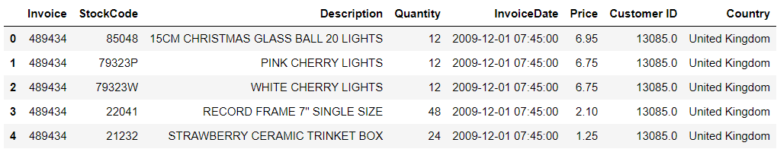
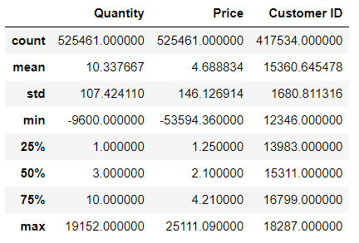
Dataset Description
https://archive.ics.uci.edu/ml/datasets/Online+Retail+II
8 columns, 525460 rows with the following features:
6 Categorical features (Invoice, StockCode, Description, InvoiceDate, Customer and Country)
2 Numerical features (Quantity and Price)
Missing/Null Values:
Description: 2928
Customer ID: 107927

Slide 6
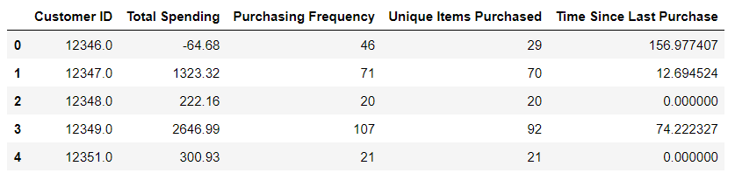
Exploratory Data Analysis (EDA)
Creating 4 new features:
Total Spending
Purchasing Frequency
Unique Items Purchased
Time Since Last Purchase

Slide 7
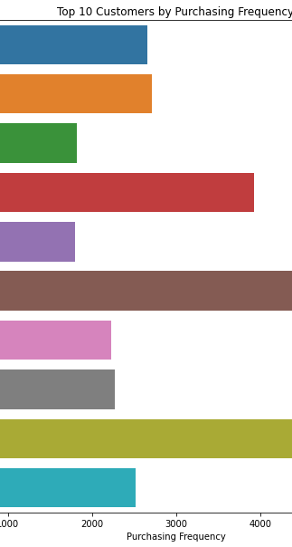
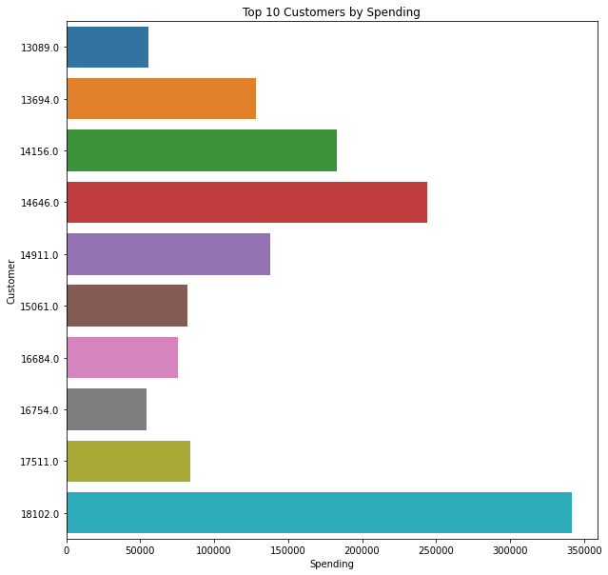
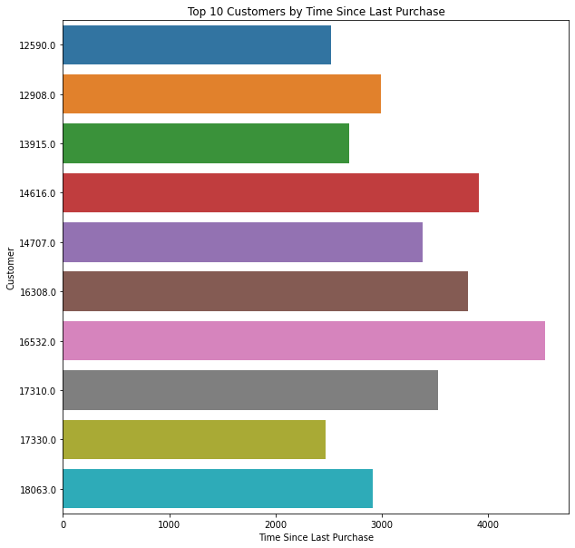
Exploratory Data Analysis (EDA)

Slide 8
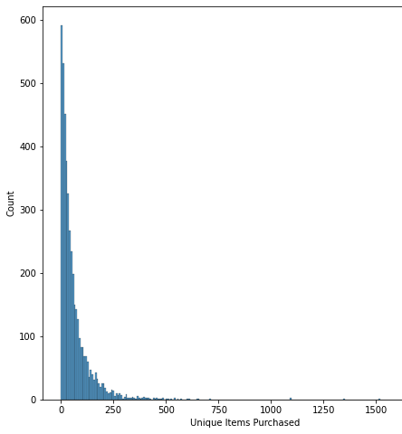
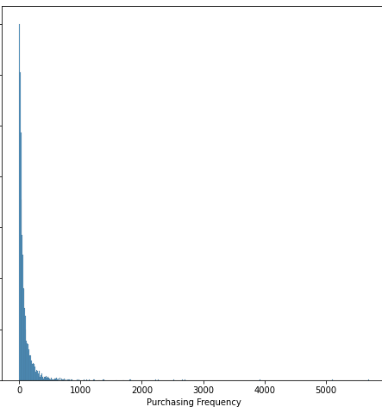
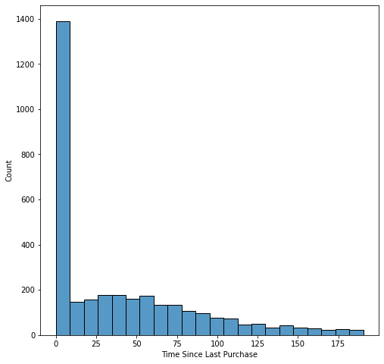
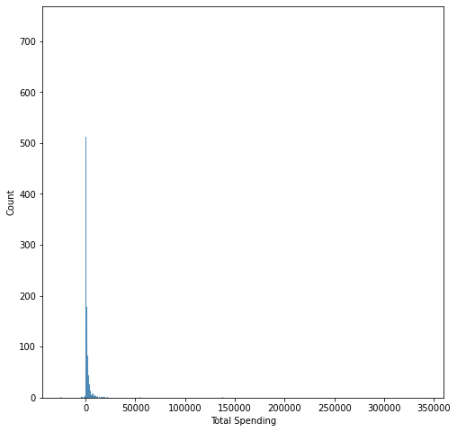
Exploratory Data Analysis (EDA)

Slide 9
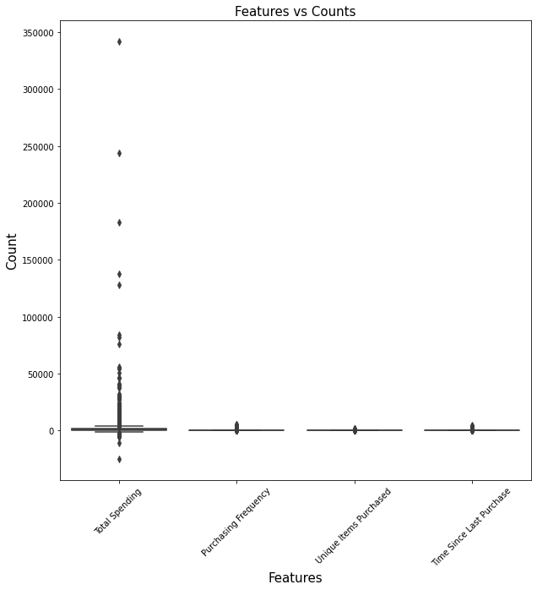
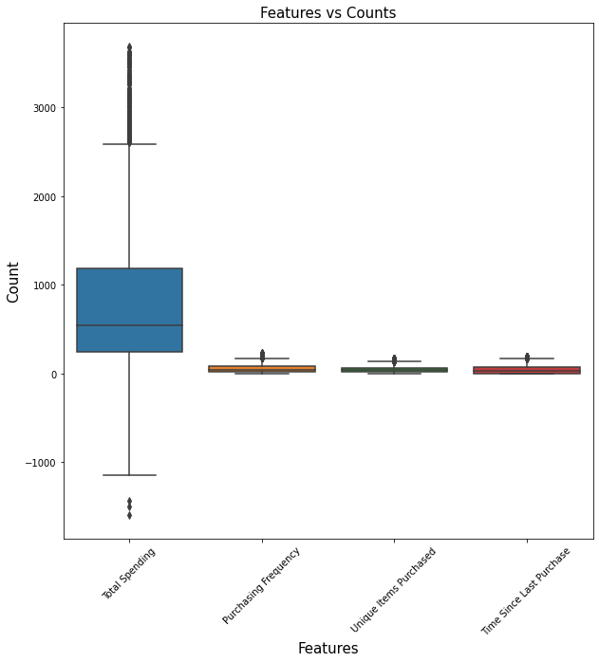
Exploratory Data Analysis (EDA)

Slide 10
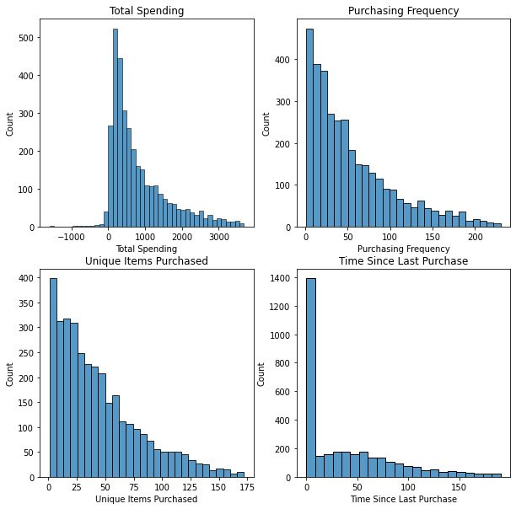
Exploratory Data Analysis (EDA)

Slide 11
Model Selection and Evaluation
Models Used:
K-Means
Hierarchical Clustering
DBSCAN
Gaussian Mixture Model
Spectral Clustering
Metrics Used:
Silhouette Score
Calinski-Harabasz Index
Davies-Bouldin Index

Slide 12
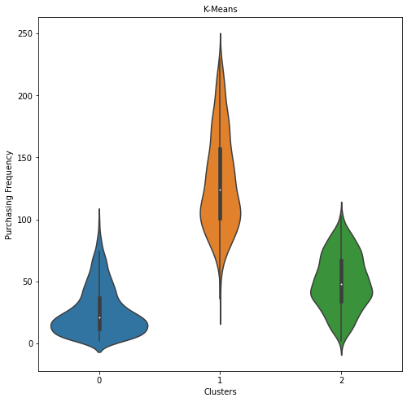
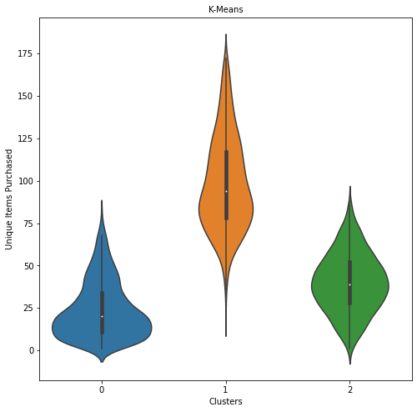
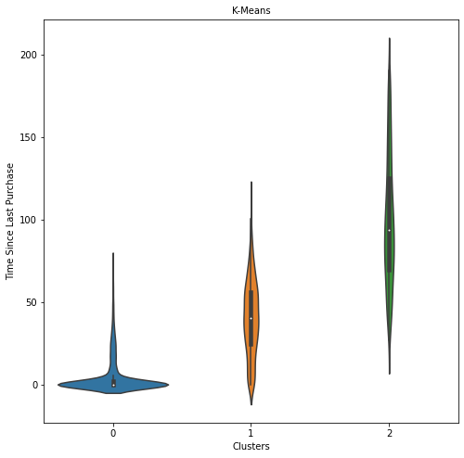
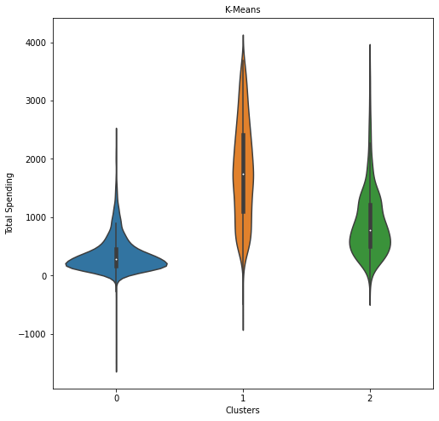
Customer Segmentation
K-Means Clustering:
Cluster 0:
Lower spending habit
Infrequent purchases
One-time buyers
Cluster 1:
Higher spending
Frequent purchases
Diverse range of items
Cluster 2:
Between clusters 0 and 1

Slide 13
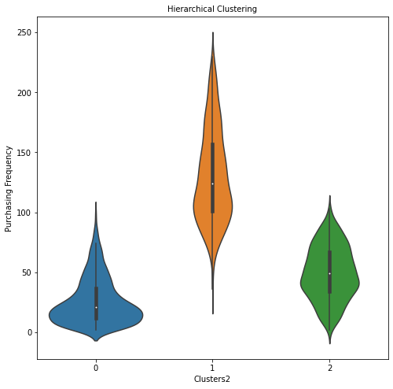
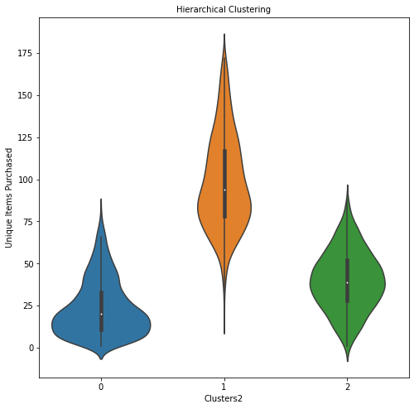
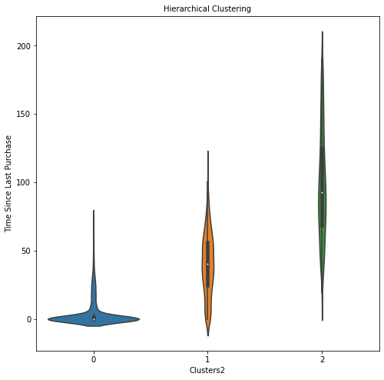
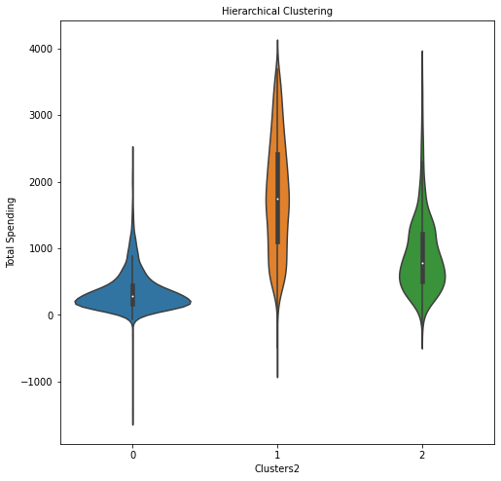
Customer Segmentation
Hierarchical Clustering:
Cluster 0:
Lower spending habit
Infrequent purchases
One-time buyers.
Cluster 1:
Higher spending
Frequent purchases
Diverse range of items
Cluster 2:
Between clusters 0 and 1

Slide 14
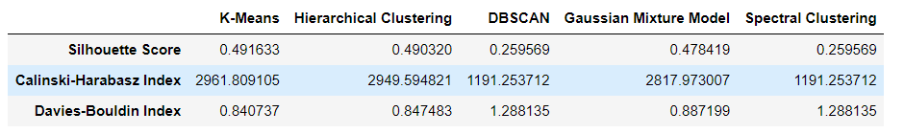
Conclusion
Best Algorithms:
K-Means
Hierarchical Clustering

Slide 15
References
https://segment.com/growth-center/customer-segmentation
https://towardsdatascience.com/the-5-clustering-algorithms-data-scientists-need-to-know-a36d136ef68
https://archive.ics.uci.edu/ml/datasets/Online+Retail+II

